Slide 1
ECE 466: Digital Signal Processing
Seyyid Emre Sofuoglu
PhD Candidate, ECE

Slide 2
Overview
Office Hours: TTh 4-5 pm, online. See D2L calendar or announcements for Zoom link.
Textbook:
J.R. Deller, Jr., Discrete-Time Signal Processing with Speech Processing Motivations.
Digital Signal Processing, J. G. Proakis and D. G. Manolakis, Prentice Hall, 3rd Edition. Secondary book. (P&M)
Not necessary to buy them. Can still be helpful to have the second. The first is electronically available in the library and will be shared in D2L, and the second can be found in the library.

Slide 3
Requirements:
2 Midterms: 25% each.
Homeworks: 15%.
7-8 Homeworks.
10 points. Might have bonus.
Can work in groups of 2.
Late by a day, 2 points reduced. 2 days – 8 pts.
Term Project: 25%.
Can work in groups of max 3.
Topic(s), description will be given.
Attendance: 10%
Pop up quizzes. In zoom and in person.
Coding assignments.

Slide 4
Policies:
No cheating.
Use discussion forum in D2L. No direct answers or links to direct answers to the HW question.
Will use Python. There will be some in-class coding and I will share libraries. Otherwise, you’re on your own. (Hint: discussion forums)
Let me know you.
Ask questions. Here to teach, not grade.

Slide 5
Course Outline
Signals and Systems:
Analog and Digital
Discrete Time S&S.
DT System Response in Time Domain:
Convolution sum
Difference equations
Frequency Domain:
Z-transform.
Discrete Fourier Transform
Machine Learning for Signal Processing.

Slide 6
But What Will You Learn?
Relationships between Digital and Analog Systems.
Why use digital?
How does the operations translate?
Is it legit? z-transform.
Time and frequency domain analysis of digital systems.
How to better understand, analyze and model digital systems?
Tools and skillset for digital signal processing.
Operators that correspond to their counterparts of analog signal processing, such as Fourier transform, convolution, ...
Machine Learning for SP.
Generally, we would have learned filter design.
Off the shelf algorithms take care of that.

Slide 7
Digital Signal Processing
What is analog? What is digital?
Uncountably infinite vs finite.
What are signals?
Measurements of physical phenomena.
Can we process analog signals? Quiz time!
Why digital?
Possible.
Quantization -> Noiseless recovery.
Can model more than simple functions.
Can compress really well.
A full HD image: 1920x1080x3 -> ~ 6M pixels -> 6MB
30 FPS -> 180MB/s -> ~10.8GB/m -> 648GB/h

Slide 8
DSP
We are in a processor. Time is now index.
x(t) -> x[n]
How much do we lose? Can we model real signals like this?
The catch? Quiz time! (Hint: sampling)
Systems are now simulated. Algorithms.
Changing systems, sending information is easy. Change a couple of bits.
Money transfers, bitcoin. Games, levels. Movies, live streaming.

Slide 9
Applications:
Communications.

Slide 10
Classification of Signals
Univariate vs Multivariate: x(t) vs I(i,j)
Single channel vs multi-channel: x(t) = a or x(t) = [a, b, c]
Continuous time vs discrete time: x(t) vs x[n]. Sampling.
Is this a real difference? Are there any continuous time signals?
Continuous valued vs discrete valued: x(t) ϵ R vs x(t) ϵ {1,2,3,…}. Quantization and/or measurement.
Analog: ct, cv.
Digital: dt, dv.
Deterministic vs random: x(t) = cos(t) vs x(t) = ?
Can any real signal be deterministic? Quiz time!
Periodic vs aperiodic: x(t) = x(t+T) vs else.

Slide 11
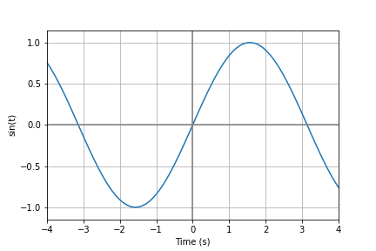
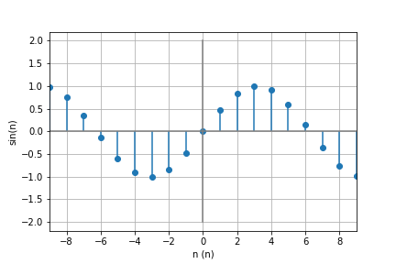
Frequency in Discrete Time
Continuous time sinusoidal vs DT sinusoidal
x[n] = x[n+N], N: Fundamental Period. What is 1/N?
Is a sinusoidal sin(2πfn) periodic in DT? Quiz time!

Slide 12
Discrete Time Signal
x[n] = x_{a}(nT), T: sampling period. Fs = 1/T.
Frequencies of x_{a}(t) and x[n]: F, f
X_{a}(t)=cos(2πFt) -> x_{a}(nT) = cos(2πFTn) = x[n]
f = FT = F/Fs, ω = ΩT.
If Fs is Nyquist, what is the range of f? Quiz Time!
Higher multiplicities fold.
f = 1 -> x[n] = cos(2πn) = 1 -> f=0
f = 3/4 -> x[n] = cos(3π/2n) = cos((2π-π/2)n) -> f = -1/4
cos(k(2πn)+2πfn) = cos(2πfn)

Slide 13
Analog to Digital
Sampling
Quantization
Coding
Fs/2>F_{max}
-1/2<f<1/2
x_{max}, x_{min}
L
Δ = (x_{max}- x_{min})/(L-1)
L↑, error↓
Binary labels.
2^{b} ≥ L or b ≥ log₂ L

